Slide 1
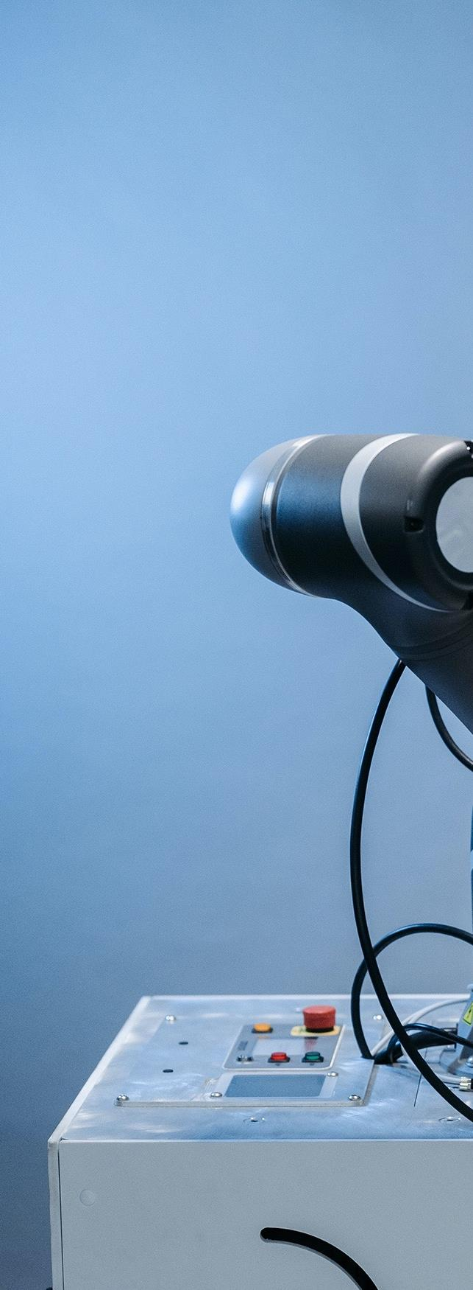

Prediction of Precipitation in London

Slide 2
Users
Meteorologist Agencies
Energy Companies
Urban Planners
Agriculture
Weather Forecasters
BC Hydro
Infrastructure
Farmers

Slide 3
WorkFlow
01
02
03
04
EDA
Model Selection
Model Evaluation
Recommendation

Slide 4

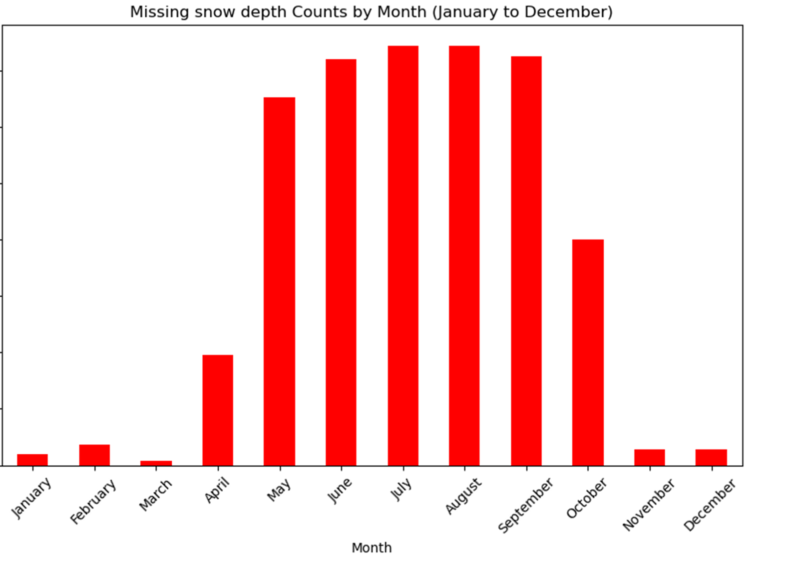
Pre-Processing
Removed rows with any null values
SD made the decision to convert all null values to 0
Removed rows with strange outliers such as TX < TN

Slide 5
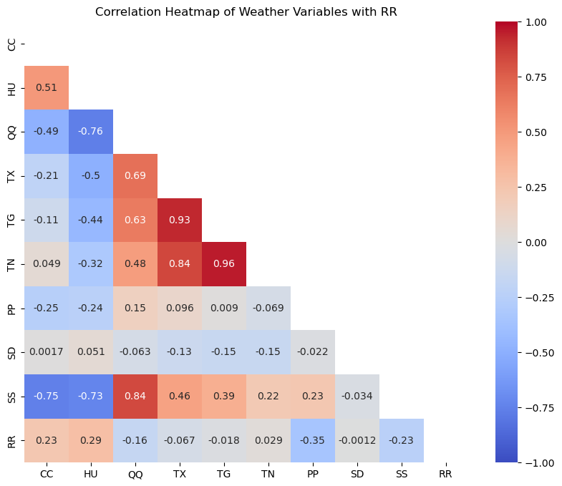
Pre-Processing
Strongest positive correlation is with HU (Humidity)
Strongest negative correlation is with PP (Pressure)

Slide 6
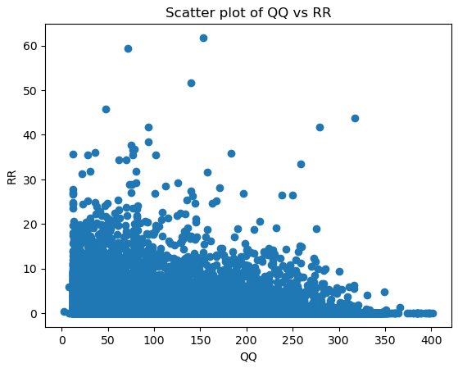
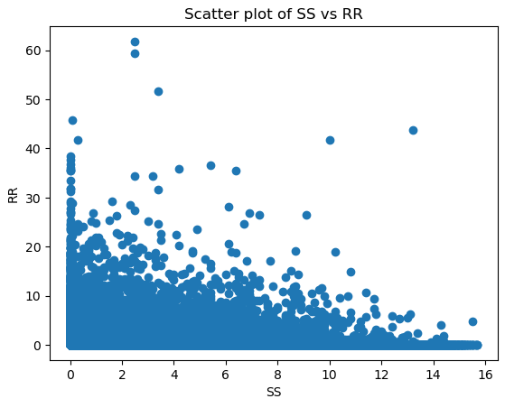
Pair-Plot with Precipitation

Slide 7
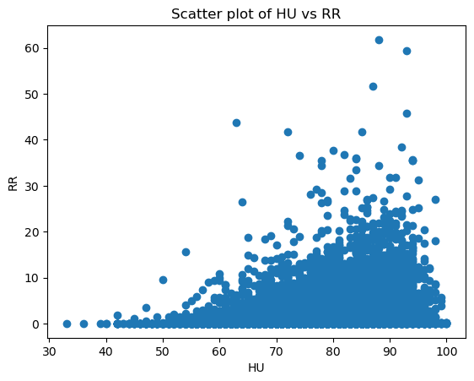
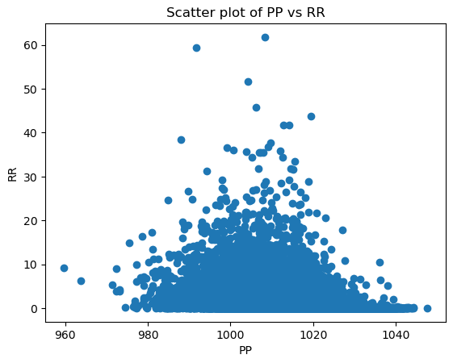
Pair-Plot with Precipitation

Slide 8
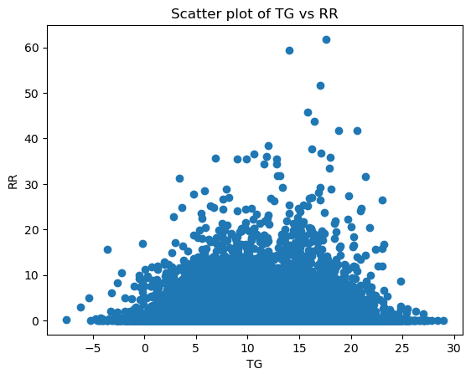
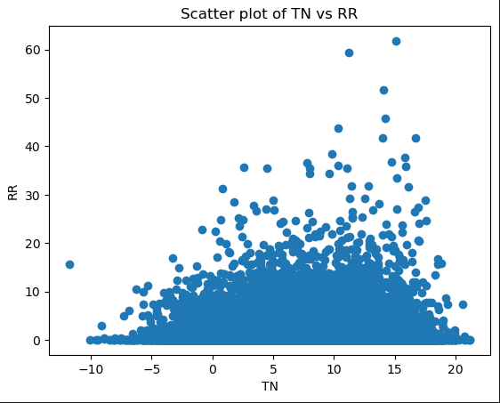
Pair-Plot with Precipitation

Slide 9
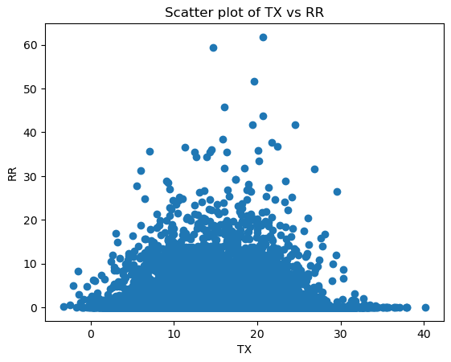
Pair-Plot with Precipitation

Slide 10
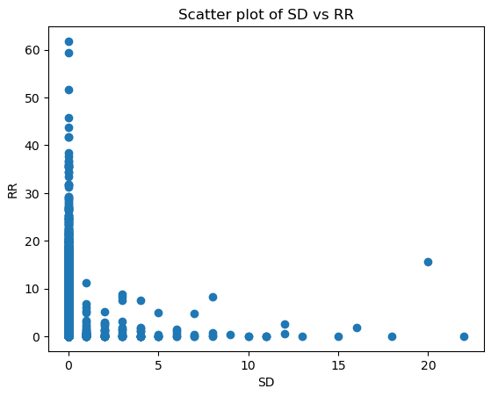
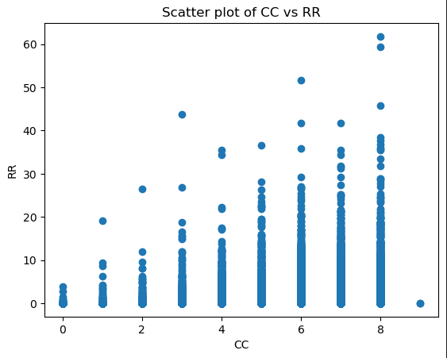
Pair-Plot with Precipitation

Slide 11

LGBM
Fast training speed and high efficiency
Use of SHAP to determine top features
Run model again feature selection and then with hyperparameters

Slide 12

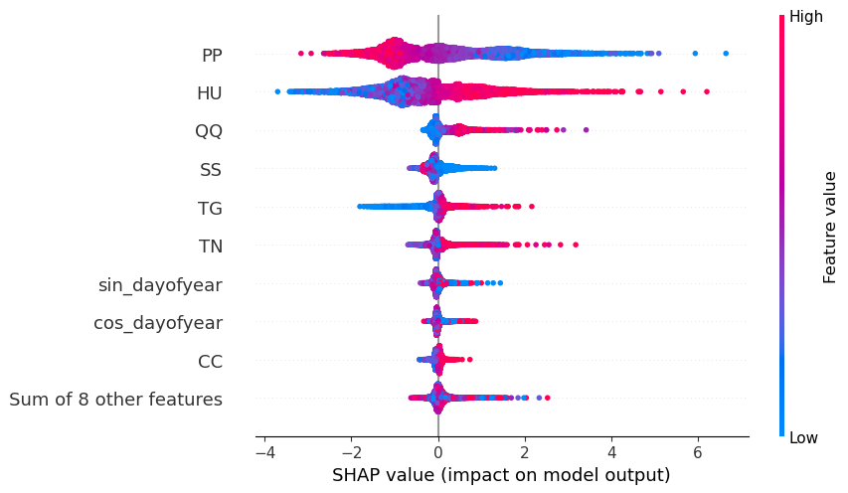
EVAL
SHAP Feature Selection

Slide 13
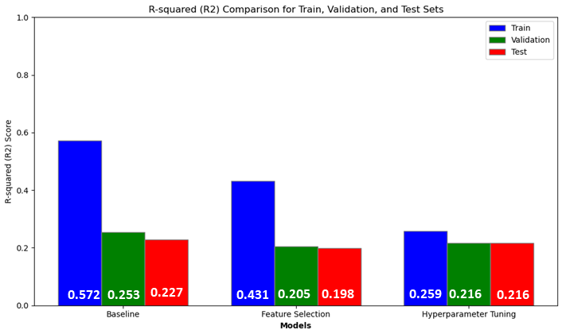
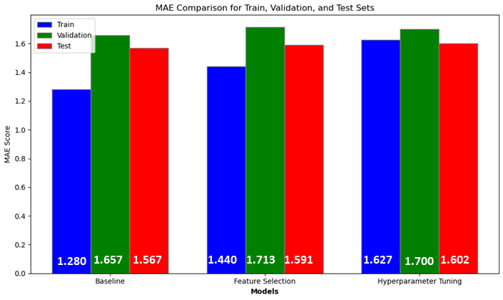
EVAL
Performance Metrics

Slide 14
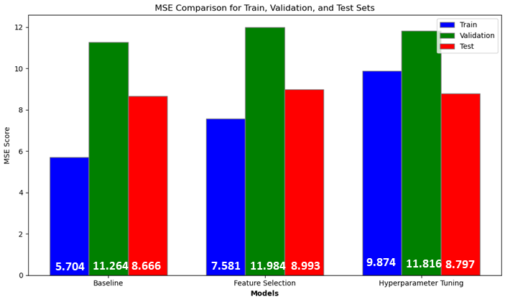
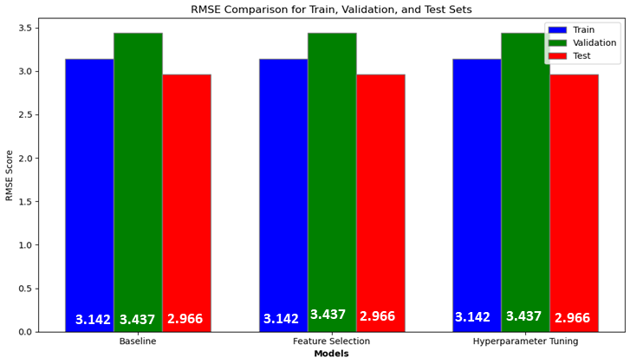
EVAL
Performance Metrics

Slide 15
XGBoost
Helpful for imbalanced data
Possible better predictiveness
Use Polynomial transformation to generate polynomial and interaction features then SHAP to determine top features
Run model again feature selection and then with hyperparameters

Slide 16
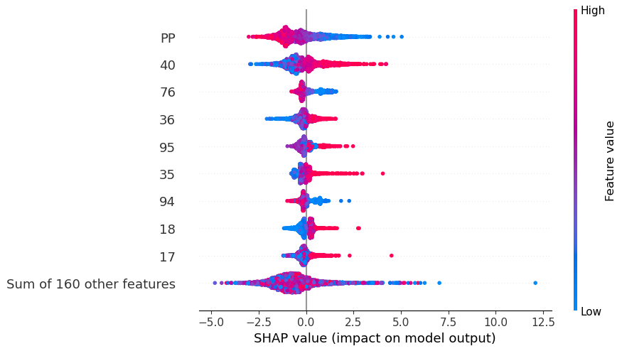
EVAL
SHAP Feature Selection

Slide 17
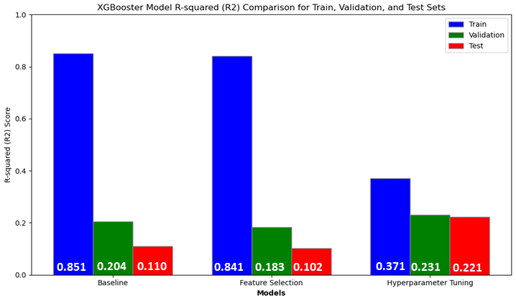
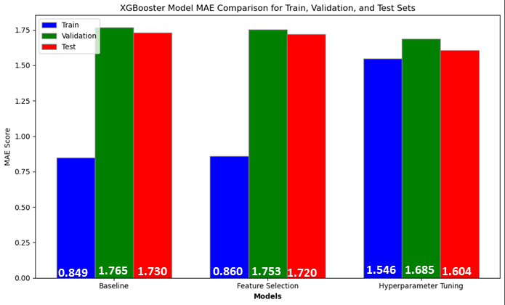
EVAL
Performance Metrics

Slide 18
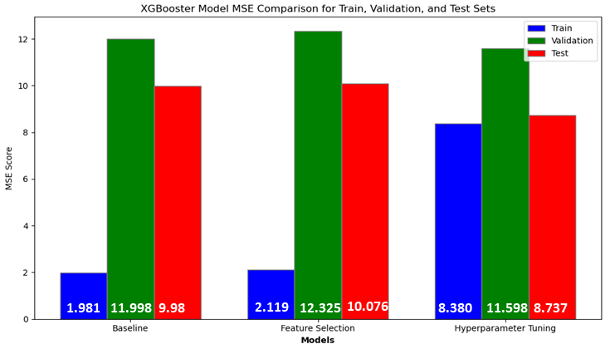
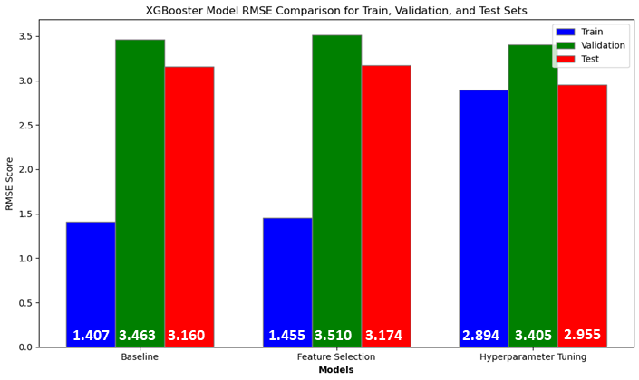
EVAL
Performance Metrics

Slide 19

Comparisons between Models
Performance Metric (Test) | Tuned XGBooster Model | Tuned LGBM
R2 | 0.2240 | 0.2256
MAE | 1.6187 | 1.5902
MSE | 8.7101 | 8.6927
RMSE | 2.9513 | 2.9483

Slide 20
Comparisons between Models
XGBooster likely needs to incorporate more of features
Tuned LGBM better for real world usability
Faster and more efficient
Better for larger datasets

Slide 21
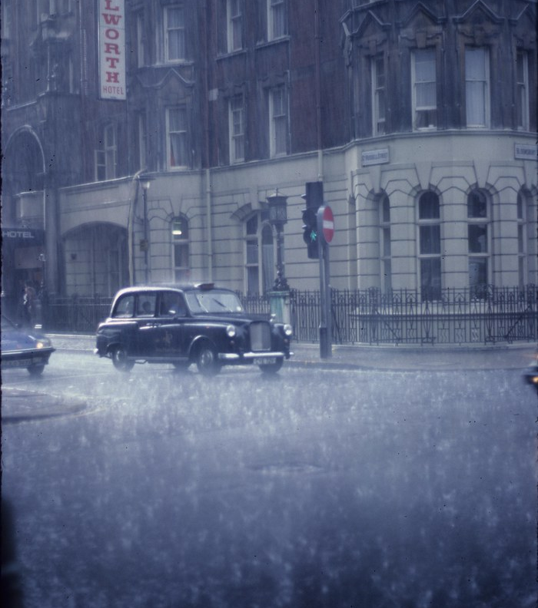

CONCLUSIONS

Slide 22
Conclusions
Better models that incorporate more interacting features
Precipitation highly variable therefore gather more information to use
Missing features:
Prevailing winds, Topography (elevation), Pollution, Water bodies (distance from them eg: River Thames)
Improve optimization and use forecast methods such as VARMA, DeepAR

Slide 23
Credits Slide
Data was attained from European Climate Assessment & Dataset
Reference
https://www.ecad.eu/dailydata/index.php

